Slide 1
Support Vector Machine
Data: letterdata

Slide 2
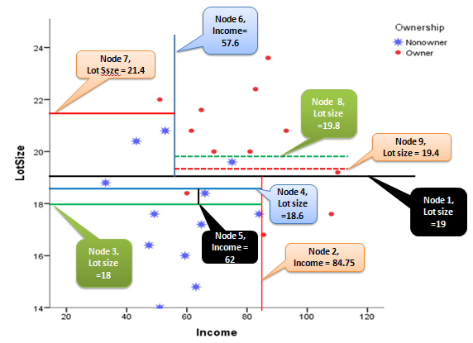
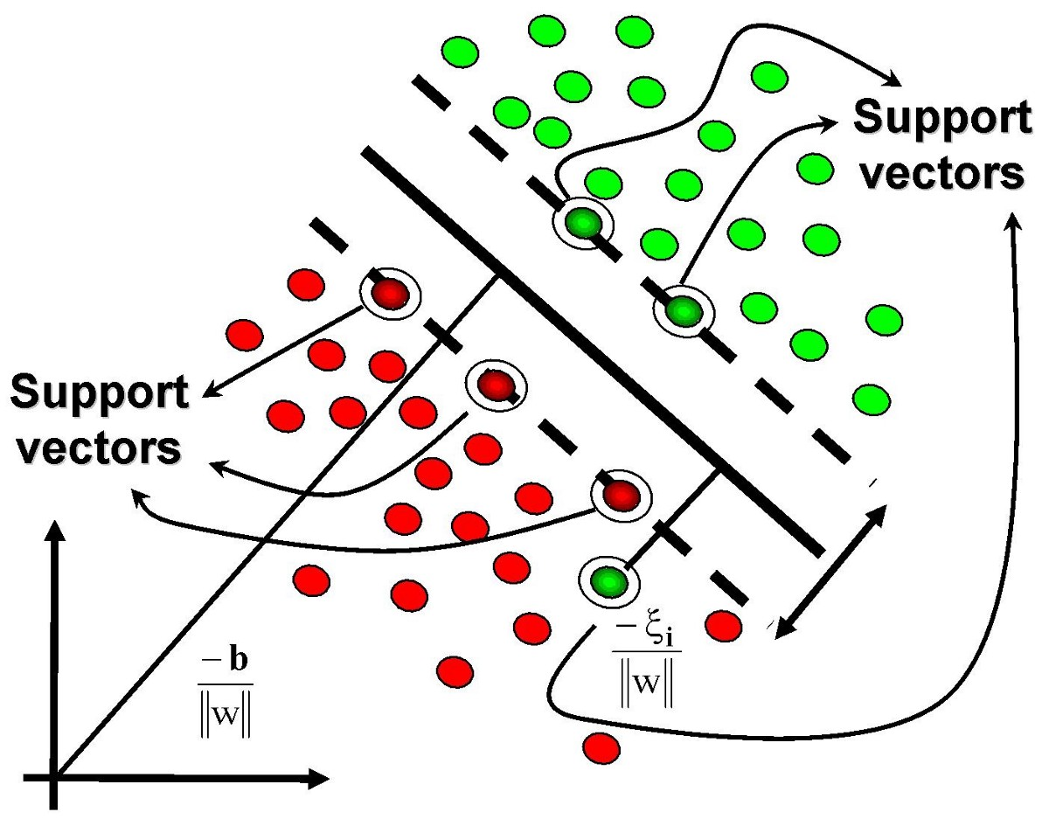
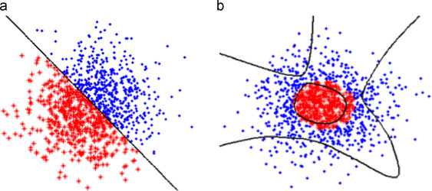
Decision Tree versus SVM

Slide 3
Support Vectors, Hyper Plane
Hyper Planes
Combination of Lazy Learners (Nearest Neighbor Classifiers) and Linear Regression

Slide 4
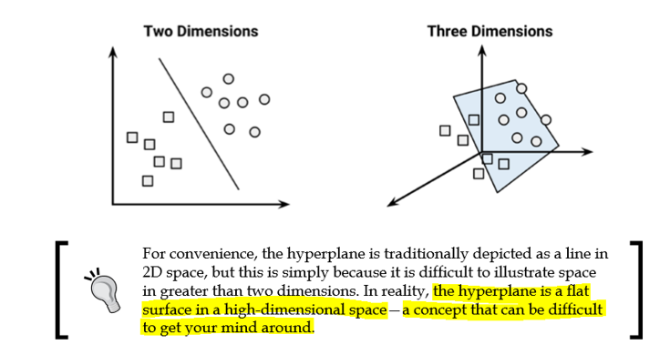
Hyperplane

Slide 5
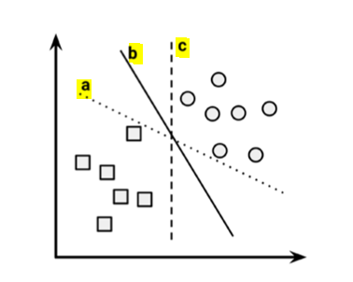
MMH (Maximum Margin Hyperplane)
Among a, b and c which one you will choose as a final separator?
Observe the red arrows with line b
Always remember that your model has to classify unseen data (Cross Validation)

Slide 6
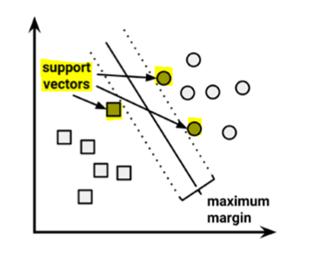
Support Vectors
You have chosen b as a final separator, correct?
Important Term

Slide 7
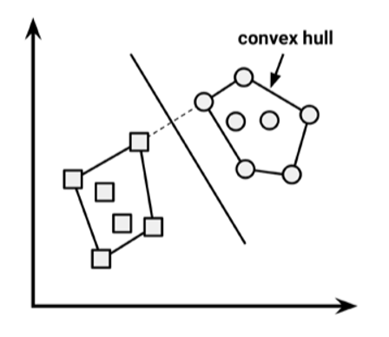
Convex Hull: Linearly Separable Data
MMH is the perpendicular bisector of the shortest line between the two convex hulls.
Quadratic Optimization is used for finding MMH
Shortest line between two convex hulls

Slide 8
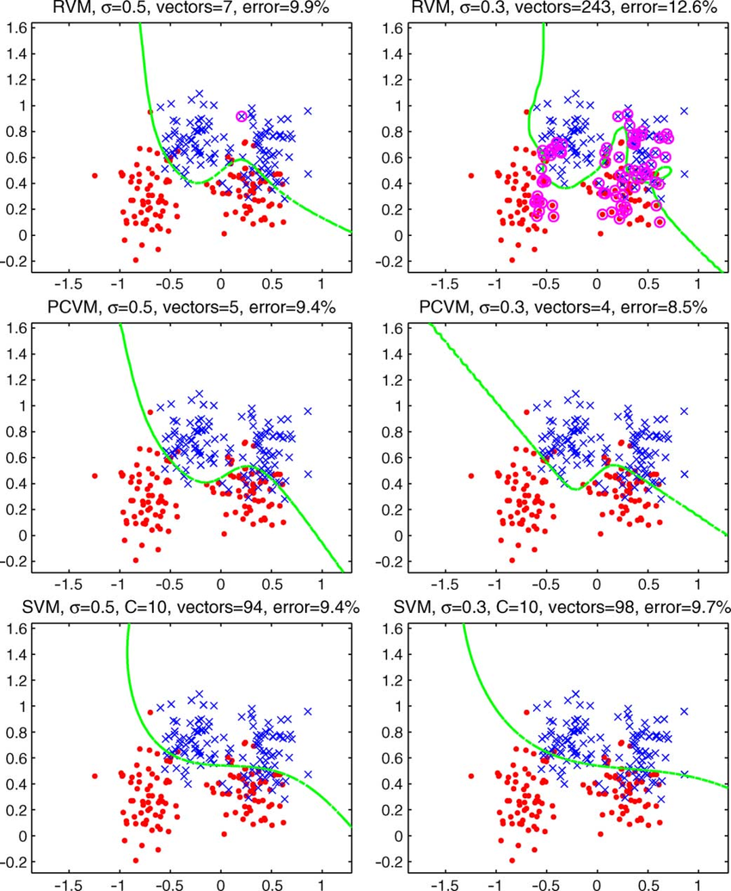
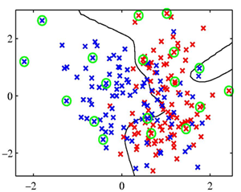


Non Linear Data
How to classify?

Slide 9
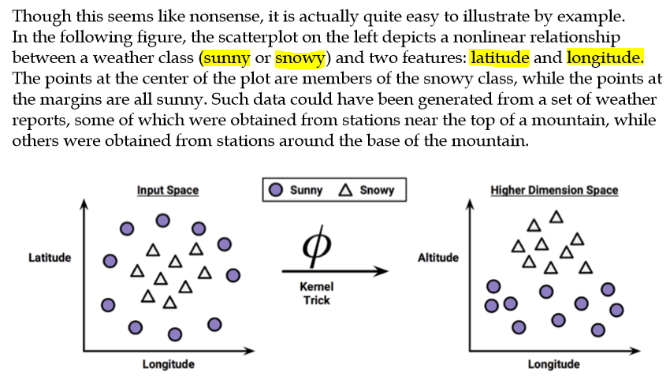
Kernel Trick

Slide 10
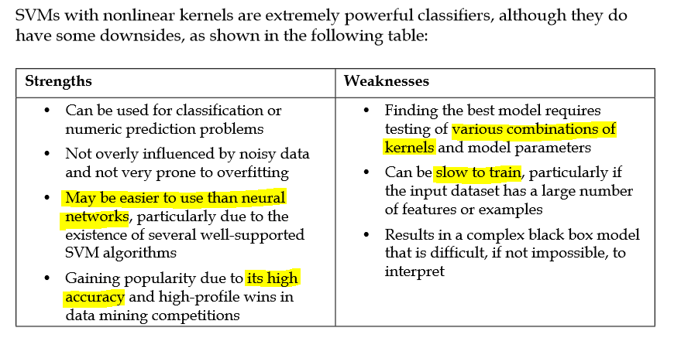
SVM: Good and Bad

Slide 11
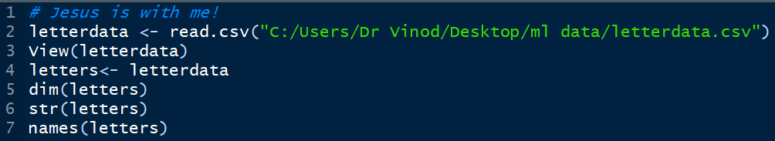
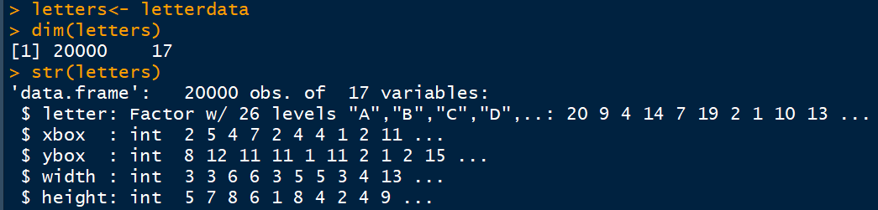
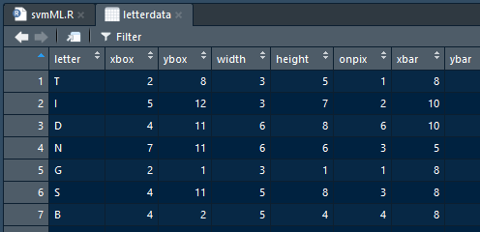
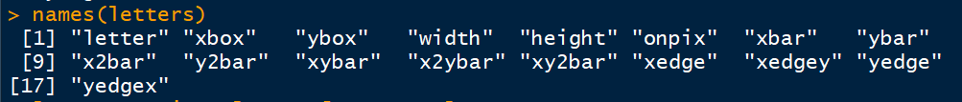
Data
Data File
Examine data

Slide 12
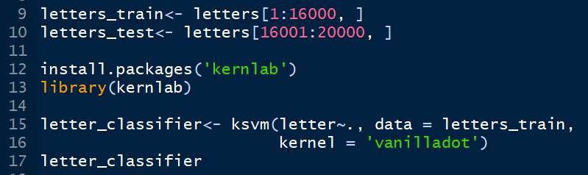
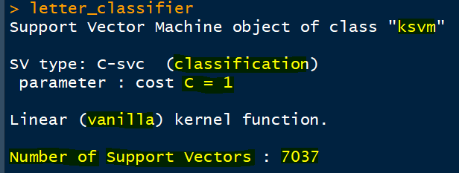

Train Data: No kernels
Support Vectors: 7037

Slide 13
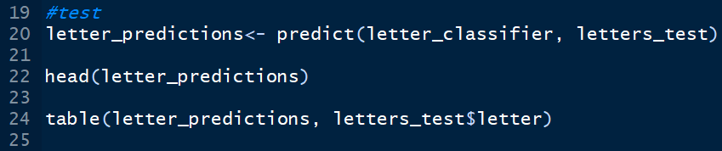

Testing
Trained Model
Test Data
Actuals
Table on next slide
First 6 predictions

Slide 14
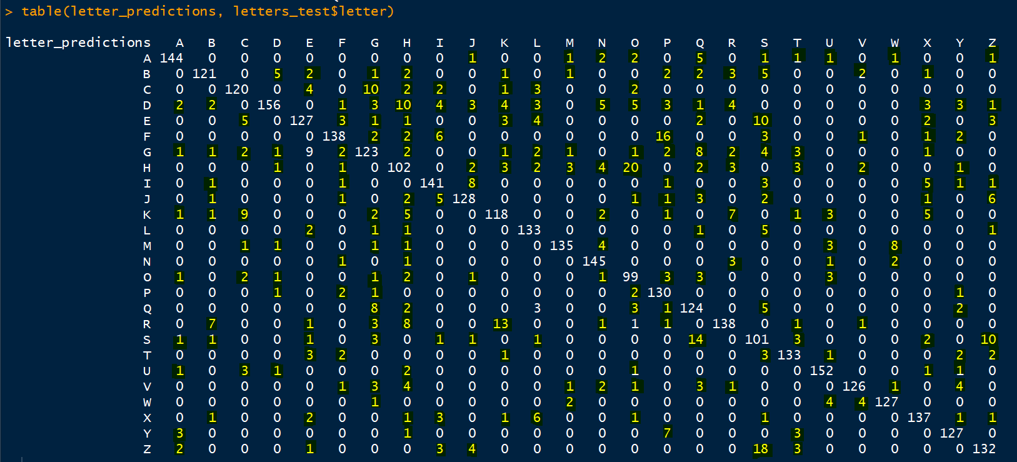
Full Table

Slide 15
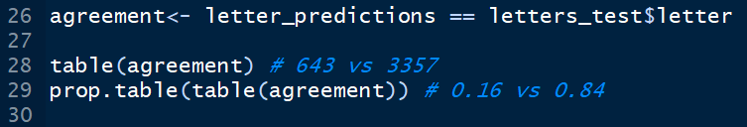
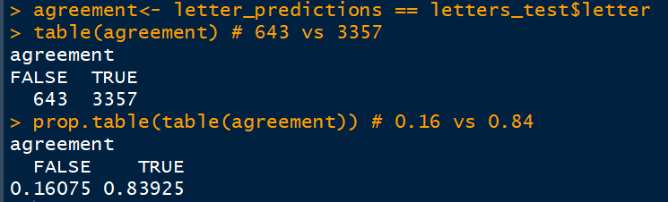
Lets find Classification Rate
Training error was 13% and Testing error is 16.10%

Slide 16
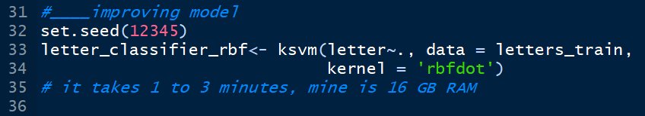
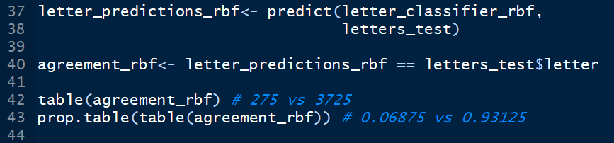
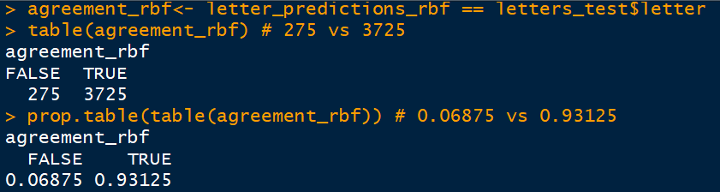

Lets improve the model
Training error was 13%, Testing error was 16.10% with NO kernel and with rbf error reduced to 6.9%

Slide 17
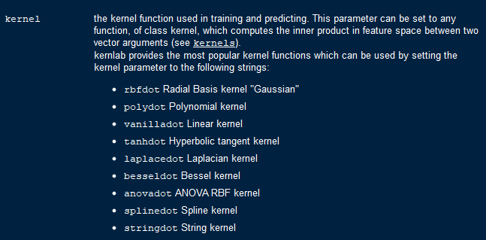
Kernels in ksvm
You have just used this →

Slide 18


Enjoy Learning!

